Slide 1


regional Maritime challenges and opportunities
PUNTLAND STATE UNIVERSITY 30.11.2019
Aaro Suonio, Strategic Adviser
EUCAP-Somalia

Slide 2

The vast oceans
71 % of surface
93.5% of all water

Slide 3
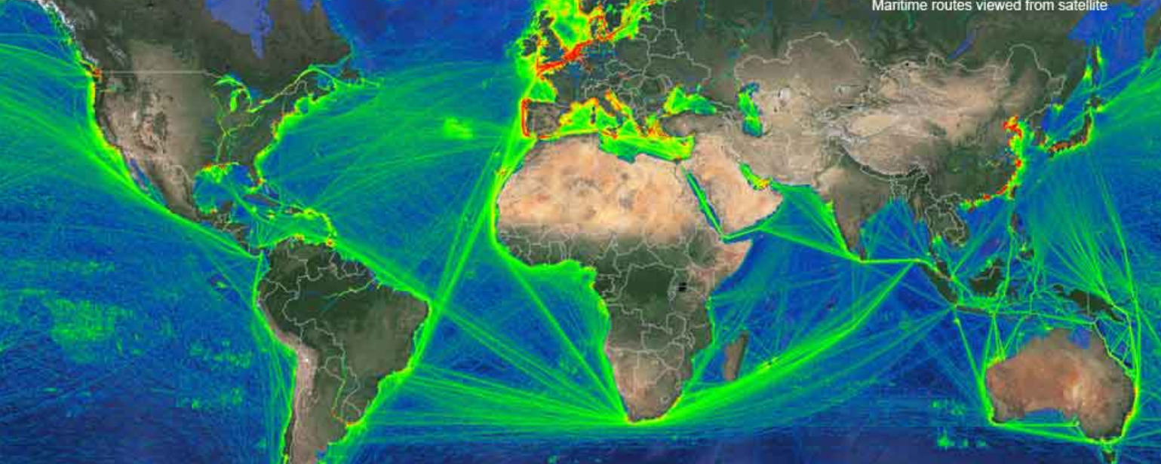

maritime routes
CRITICAL

Slide 4

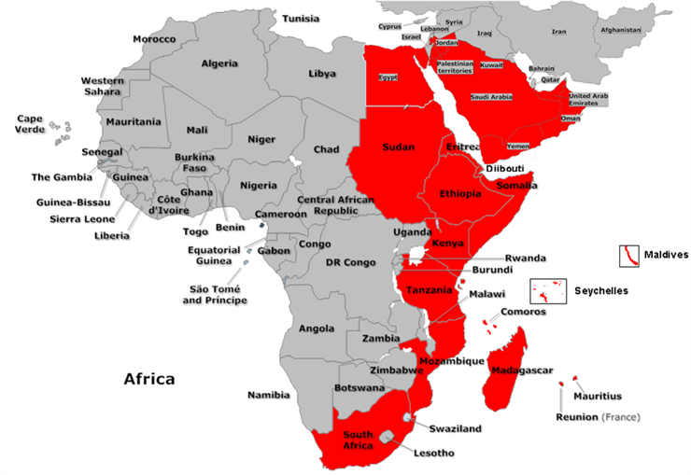
IMO:
Safety
Environmental concerns
Legal matters
Technical co-operation
Efficiency of shipping
Maritime security
21 STATES
DJIBOUTI CODE OF CONDUCT 2009
JEDDAH AMENDMENT 2017
CMR PROGRAMME
EU CRIMARIO (IORIS)

Slide 5
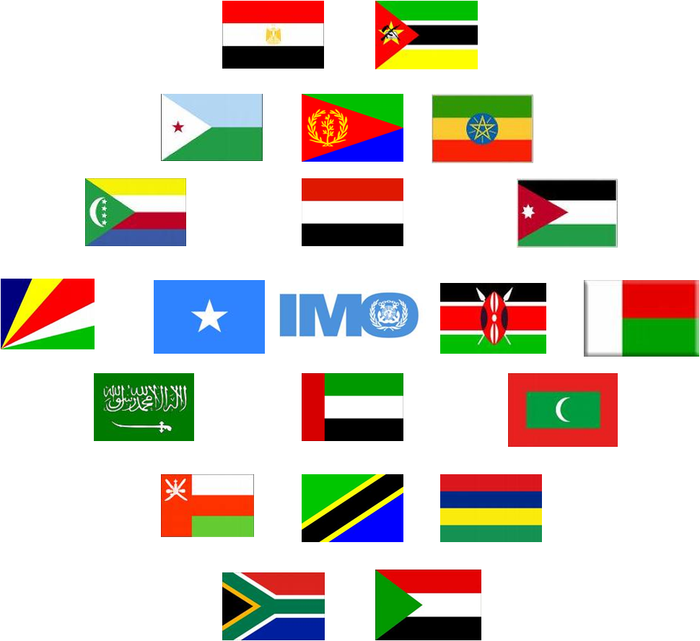
Djibouti code of conduct (DCOc)
Treaty instrument of the IMO
Repression of Piracy and Armed Robbery against Ships in the Western Indian Ocean and the Gulf of Aden
Declaration of cooperation:
investigation, arrest and prosecution, incitement or intentional facilitation
interdiction and seizure of suspect ships and property on board such ships
rescue of ships, persons and property subject to piracy and armed robbery
shared operations – officials to embark on patrol ships or aircraft of another signatory
framework for communication, coordination and cooperation

Slide 6
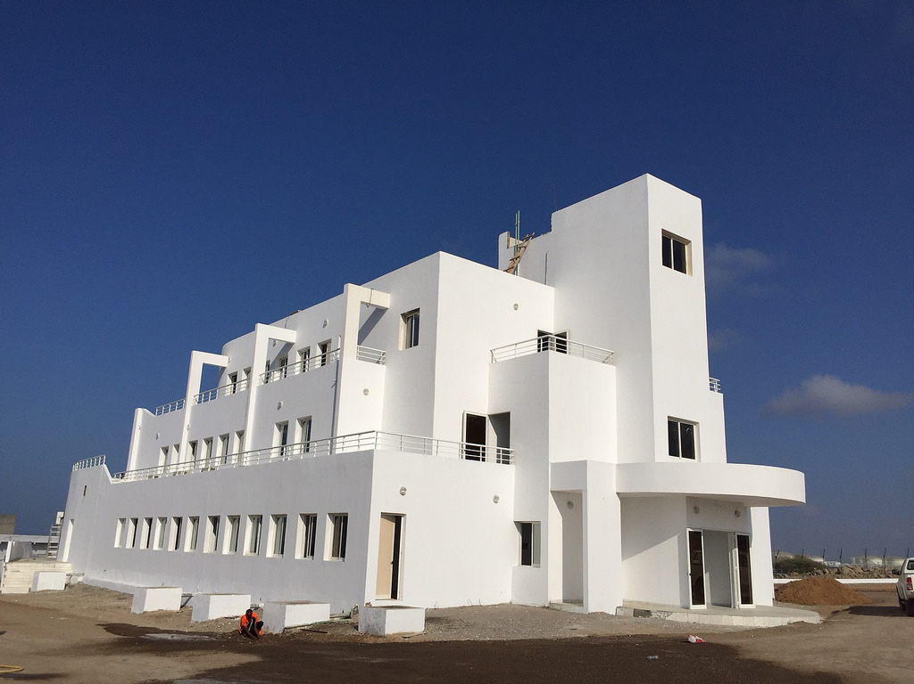
IMO DCoC - 2009
Delivering national and regional training
Enhancing national legislation
Information sharing and Maritime Domain Awareness
Building counter piracy capacity

Slide 7
JEDDAH AMENDMENT TO DCOC - 2017
Broadens scope: human trafficking and illegal, unreported and unregulated (IUU) fishing, arms trafficking, trafficking in narcotics, illegal trade in wildlife, crude oil theft, smuggling and illegal dumping of toxic waste.
Recognizes the important role of the “blue economy”
shipping, seafaring, fisheries and tourism
sustainable economic growth, food security, employment, prosperity and stability
National Strategies, Maritime Policies and legislation
Coordinate activities to facilitate rescue, interdiction, investigation, and prosecution.

Slide 8
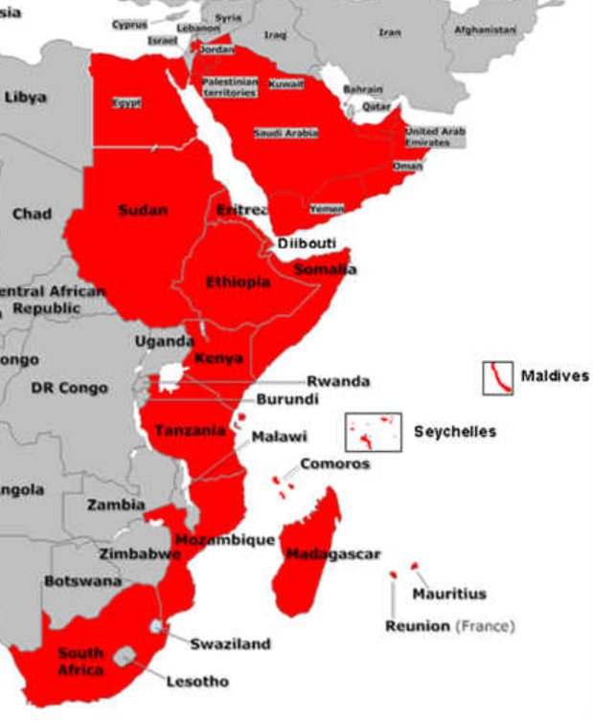
Eu crimario I 2015 - 19
Enhancing maritime situational awareness (MSA)
Web based information sharing and incident management network (IORIS)
Training & capacity building
Workshops: enhancing interagency and regional cooperation
Budget of €5.5 million
CRIMARIO II

Slide 9
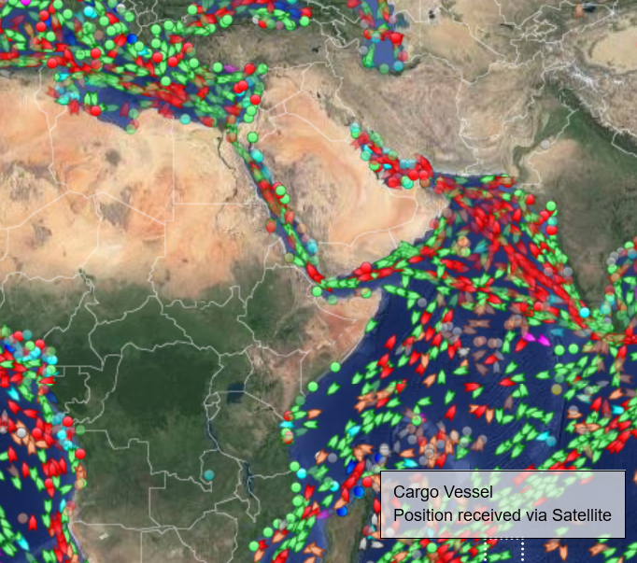

ECONOMICs in figures
Main trade route for dry commodities and containerized cargo between Asia, Europe and the Americas.
Nearly 20 000 vessels / year
Millions of tons of crude oil, petroleum products, gas, grains, iron ore and coal, containerized goods from Hi-Fis to toys every month
7% of world oil consumption passed through the Gulf of Aden in 2007
Around 30% of Europe’s oil

Slide 10
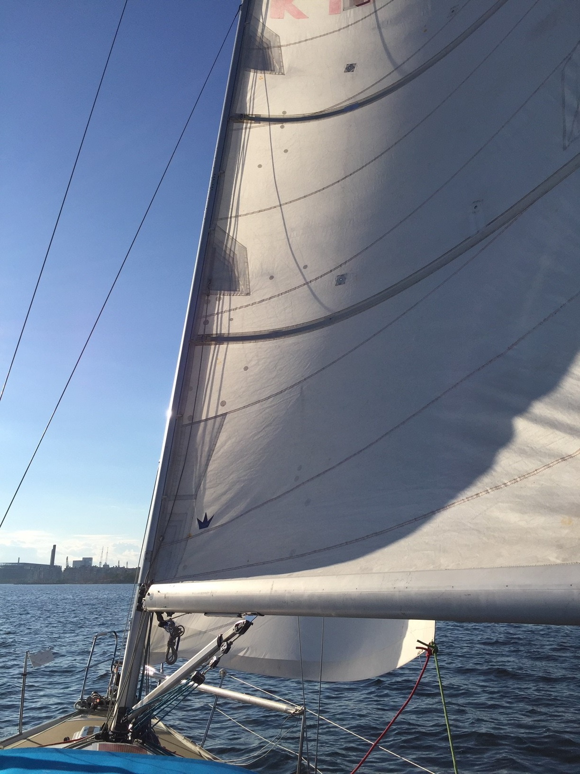
MAHADSANID!
QUESTIONS?

